Slide 1
Corpus Christi Home Groups
By: Chris Maxel, Elliot Wirrick, Jordan Wood, and Matt Dean
Notes:
[ Chris ]

Slide 2
Overview of presentation
Introduction
Initial Status
Our Work
Takeaways
Conclusion
Notes:
[ Chris ]

Slide 3
Introduction
Notes:
[ Chris ]

Slide 4

Arco Church
“To grow together in covenant relationship under the Lordship of Jesus Christ”
Struggling with congregation attendance
Stagnant despite about 50 new visitors per week
Needed a course management system to take attendance
Previously keeping inaccurate records in Excel sheets
Notes:
[ Chris ]
Arco is a church in Cuenca, Ecuador.
Mission statement on their website is …
Unfortunately, this amazing church in Ecuador has some problems.
Arco gains about 50 new people each week but the total church attendance isn’t going up.
The church was using excel to keep track of their attendance and home groups. This caused errors because of inaccurate record keeping.
One solution would be to use a class management system…
And that’s how Corpus Christi was born.

Slide 5
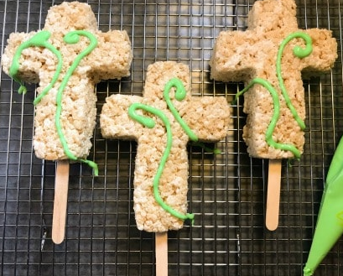
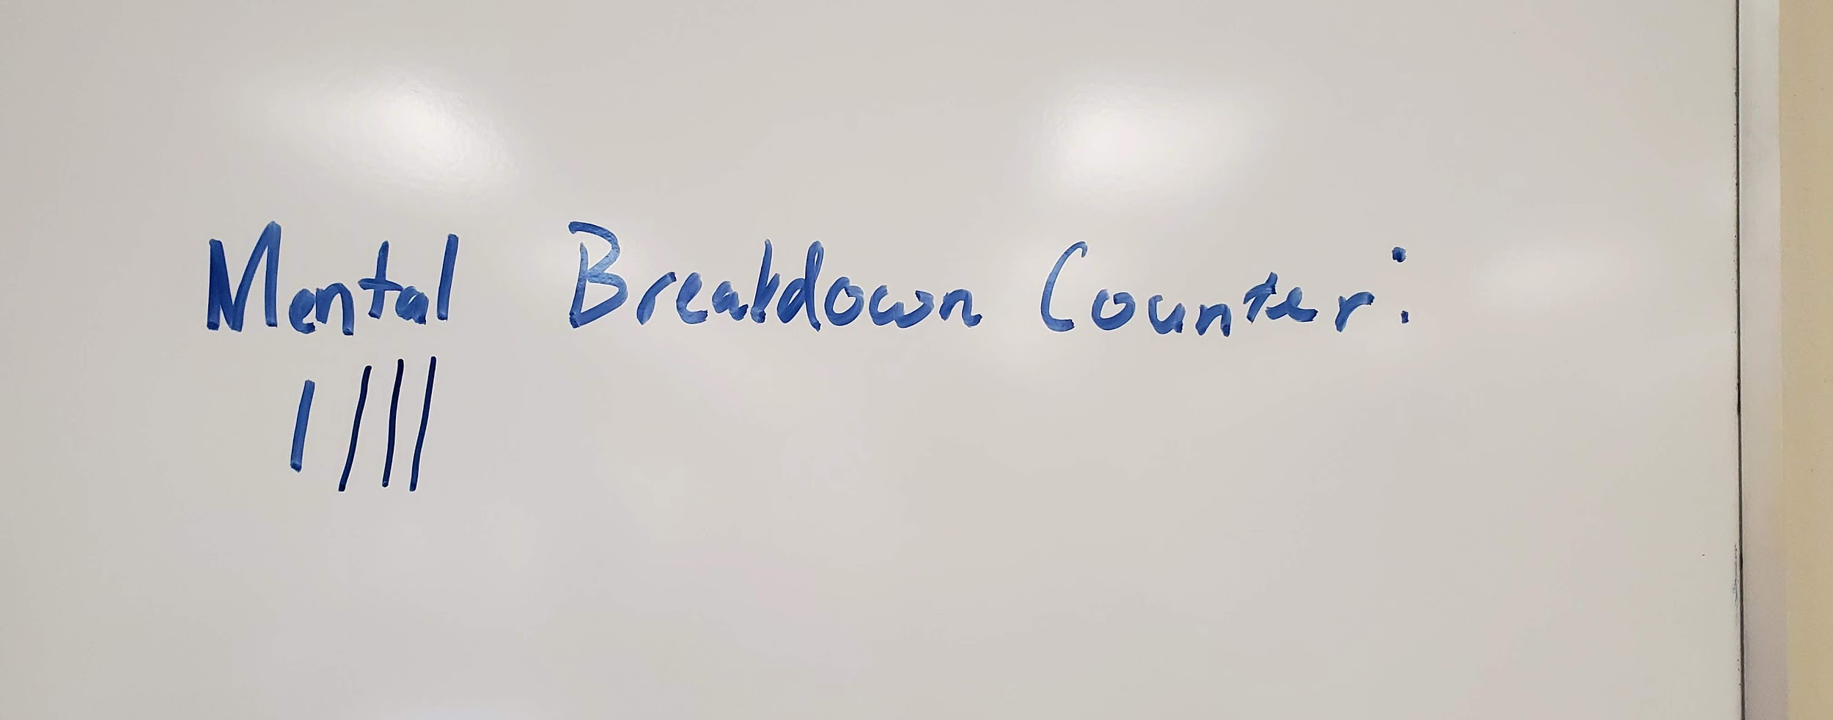
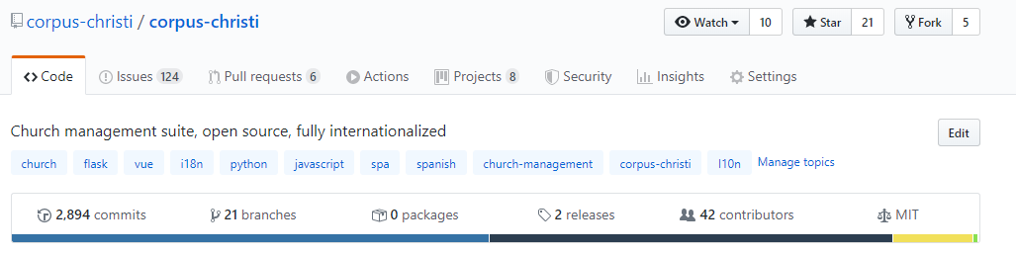

Corpus Christi was Born
Created by Dr. Nurkkala
Latin for “Body of Christ”
Designed for any church with multilingual functionality
Often called “Corpus Chrispi”
https://github.com/corpus-christi/corpus-christi
Notes:
[ Chris ]
This project is created by Dr. Nurkkala.
It’s open source and on github
Corpus Christi stands for the Body of Christ in Latin
Designed to be used by any church across the globe with the multilingual functionality
We made these jokes to keep the mental breakdown counter on the low.

Slide 6

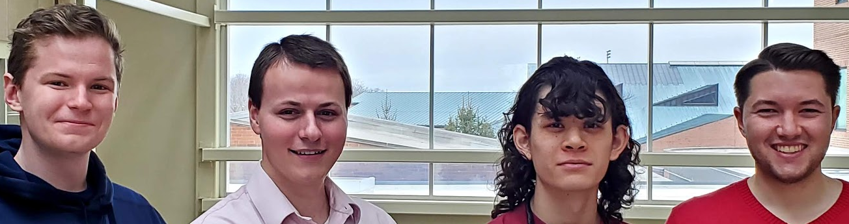
CC - Timeline
Fall 2018
ISA teams build SRS and BP
Spring 2019
Ecuador systems students continue work in ISD
January 2019
Taylor CS students travel to Cuenca, Ecuador
January 2020
Taylor CS students take on CC as Senior Project
Notes:
[ Chris ]
Let me share with you a short history of CC
After this need was established.
ISA teams drew up the plans with SRSs and BPs
Last January, a team of CS majors including myself and faculty traveled to Ecuador to build CC
This was the point in which CC became more of a reality instead of a dream
In Spring of 2019, the remaining members of the Ecuador trip in ISD continued work on CC
And now 3 teams took on modules of CC as their senior project

Slide 7
2. Initial Status
Notes:
[ Chris ]
Now I will pass things off to Jordan to talk about the initial state that we received the project in.

Slide 8
Inheriting Code
New languages and tools
Time spent reading code
Designed in an unfamiliar way
Incomplete work and old code
Database limitations
Notes:
[Jordan]
One thing we really wanted to highlight was the experience of stepping into a pre-existing code base. This brought a lot of challenges and opportunities to learn such as….
New tools and tech stack brings with it inherent challenges and learning opportunities
Entering new code base you spend a lot of time reading and understanding code
With that, understanding design decisions, why, how they work, etc.
We also encountered lots of incomplete work, and outdated code that needed modified
Took time to understand design of db, and figure out how to re-work to our needs.

Slide 9

Pre-Existing Functionality
Groups page - incomplete
Members page - limited functionality
Meetings page - nonexistent
Attendance - nonexistent
Database - needed refactoring
Notes:
[Jordan]

Slide 10
3. Our Work
Notes:
[ Jordan ]

Slide 11
Team Lead
Few existing large stories → Epics
Broken up into manageable stories
Stand-up meetings (Team & Nurk)
Team first, Members had adequate work
Favorite part - story going across kanban board
Notes:
[ Chris ]

Slide 12
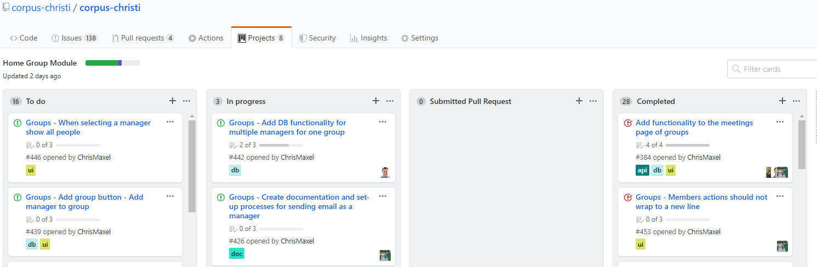
Kanban board
Kanban Board - A tool used to manage work at an individual or organizational level.
Notes:
[ Chris ]

Slide 13

Groups
Create multiple groups with ease
Formatting and validation
Convenience UI changes
Refactored DB for multiple managers
Notes:
[Elliot]

Slide 14
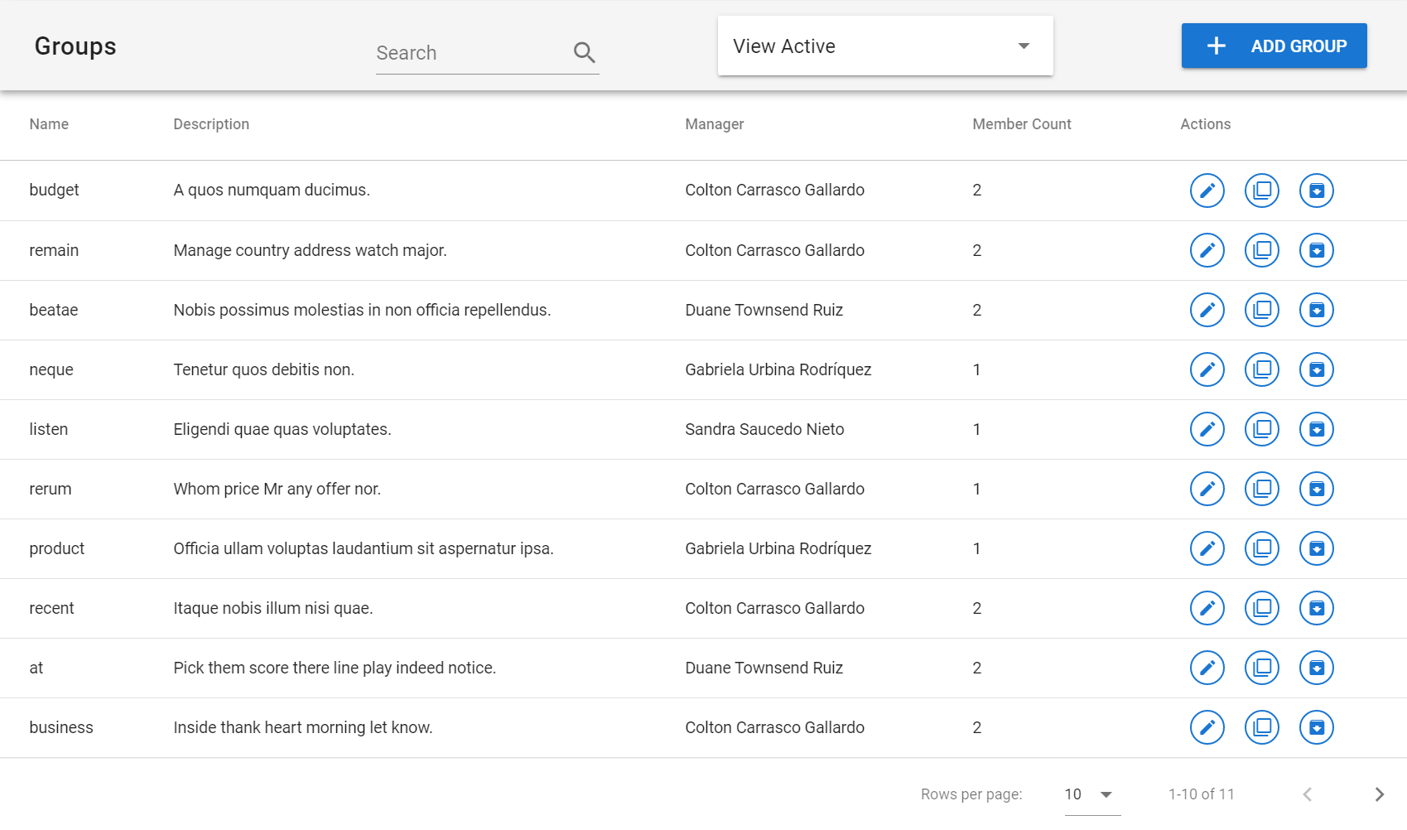
Notes:
[ Elliot ]
Added sorting to group members page
Fixed manager sort functionality on groups page
Updated group member count

Slide 15
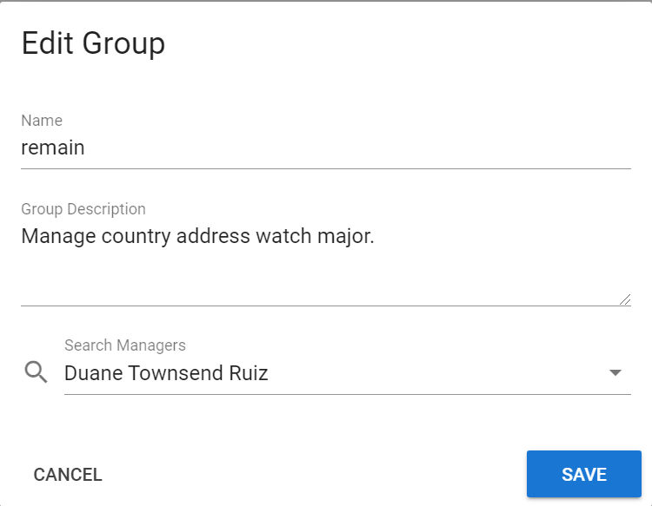
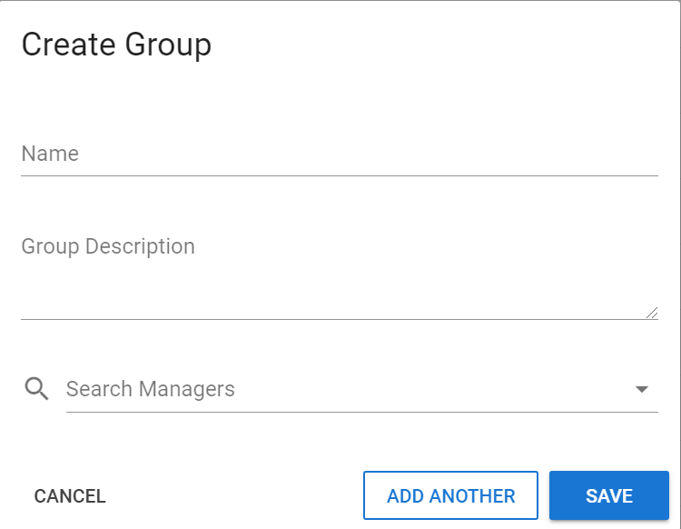
Notes:
[ Elliot ]
Added manager autofill when editing/duplicating a group
Updated groups API to return unfiltered by default

Slide 16
Meetings
Created Meetings page
Pulls Meetings from the database
Create and archive Meetings functionality
Designed for mobile friendly attendance tracking
Notes:
[Elliot]
Improve meeting page functionality

Slide 17
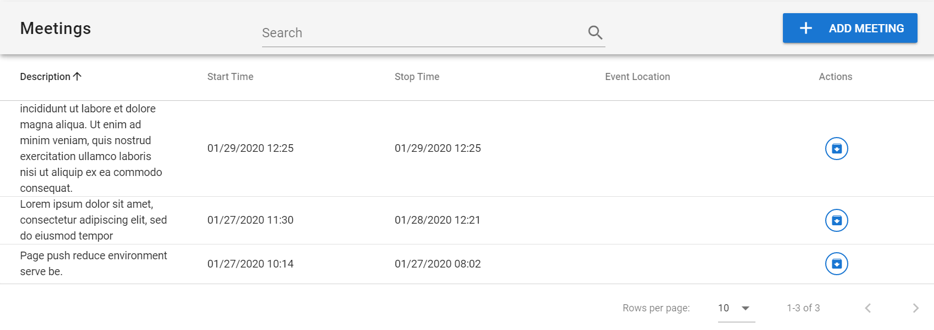
Notes:
[ Elliot ]

Slide 18
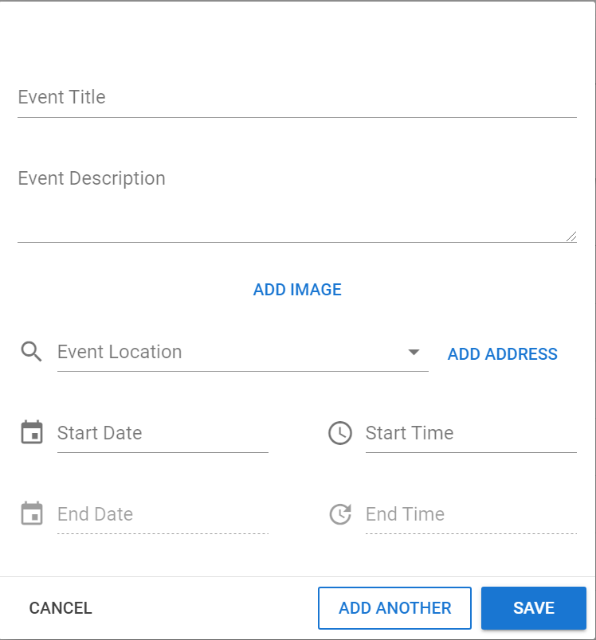
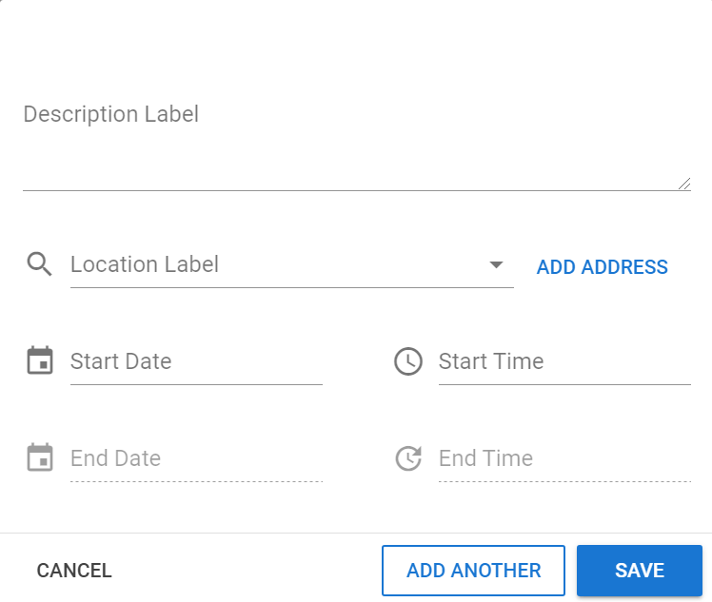
Form

Slide 19

Members
Email, Archive, and Unarchive multiple selected Members
Edit an individual Member’s information
Sort all Members by their status in the DB
Notes:
[Elliot]
Edit Group Members
Added snackbar message when manager email is not defined
Fixed button icon alignment on group member page
Fixed manager_id data key in API schema
Removed text wrap on member action buttons

Slide 20
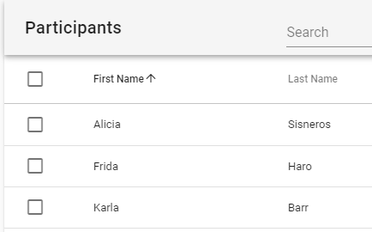
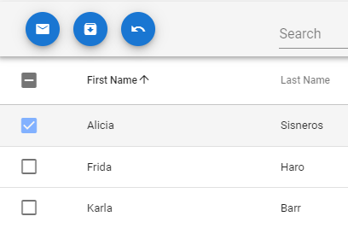
Notes:
[ Elliot ]

Slide 21
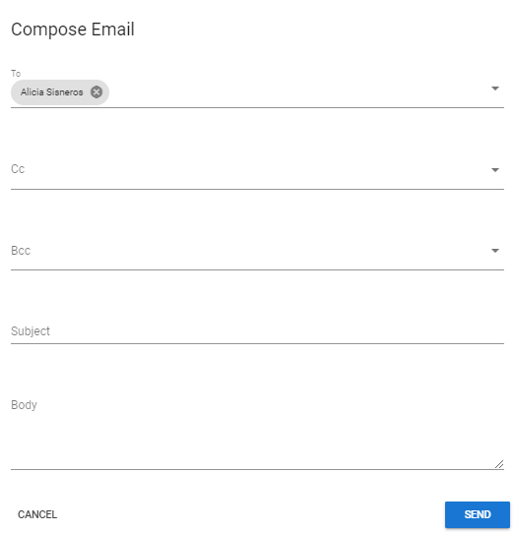
Notes:
[ Elliot ]

Slide 22
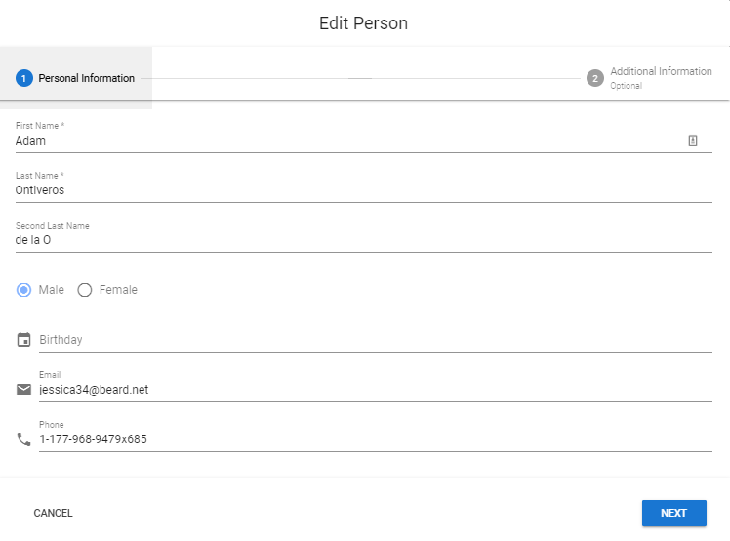
Notes:
[Elliot] ...
[Matt] So near the end of the Senior Project, we were thinking through the best way to allow a home group to have multiple managers. Next Slide

Slide 23
Notes:
[Matt] Initially, we created a Group Manager table that would facilitate a many-to-many relationship between Group and Manager. This would work, but it wasn’t the best solution. We then came to a realization that rocked our whole strategy. Next Slide

Slide 24
Group Schemas
Realization later in our Senior Project:
Church groups are similar to Home Groups
Groups can be more than Home Groups
Notes:
[Matt] The realization we came to was that the Home Groups we were designing for were too specific. We wanted groups to represent only Home Groups, when in reality, the same functionality that was required for Home Groups is the functionality that would be necessary for other types of groups in a church. In the same way that Home Group leaders might want to send emails to their group members, the pastor might want to send emails to the church board. In the same way that Home Group leaders might want to track the attendance of their meetings, Youth leaders might want to track the attendance at their youth group. It’s the same functionality; why not abstract groups? Next Animation
[Matt] So, the realization was that Groups can be more than Home Groups. Next Animation As a result, just last week, in order to facilitate the implications of this realization, we needed to fundamentally change how the management of groups works. Next Slide

Slide 25
Remove Manager of Manager concept
Add Management Types
Add Group Types
Notes:
[Matt] When I say that we changed the way group management works, what I mean is that the functionality for groups themselves mostly existed in the previous database model; the issue was that a group could only have one manager, and that groups could not have types. Consider the case of a pastor using this software. Let’s say the pastor in this church manages both the board of the church and the youth director. In the previous model, you would need to create an entry in the manager table for the pastor, and then connect that entry to each of the manager entries for the board members and the youth director in a very horizontal fashion. There would be nothing specifying what this connection actually meant. There would be no distinction between the relationship between the pastor and a board member, versus the relationship between the pastor and the youth director. So, if the pastor wanted to send an email to all the members of the board, but not to the youth director, the pastor would have to individually select the board members. In this new model, we simply put the board members in a group, and then relate the pastor through the management relation to that group. Then we create a group for the youth director and relate the pastor through the management relation to that group. Now the pastor can simply choose to send an email to the board group without individually selecting its members. So, basically, there is no longer a manager of a manager and a manager of a group; there are now just managers of groups. Next Animation. Point at Screen And what we have is this nice simple circular relation: people can manage groups, and people can be members of groups. A member of one group can also lead another group. So let’s say our board members each manage one group. Point at Screen So the pastor manages the group of board members. Each of those board members is also a person, who manages another group. We can then construct a tree for the pastor that allows the pastor to send an email to all of the people that he manages, or to all the people that the people he manages manage, and so on. Let’s extend our example a little bit and flesh out our youth director. Now our youth director manages a youth group, but he’s not the only person who manages this youth group. There are also two volunteers, and a parent who helps out once a month. Each of these leaders should have a different level of access to the youth group. Now in the model we originally envisioned, there was no management type involved. All you would’ve been able to do was assign multiple managers. Certainly the dad who helps out once a month shouldn’t be allowed to remove people from the group. But in this new model we have management types. Next Animation These management types would allow the user to define the type of management that a manager should have, and could eventually support different permissions for different types of management. Additionally, let’s say that quite a large church would like to use our software. Let’s say this church has multiple separate youth groups, with one youth director over all of them, and a few nursery groups as well. Sometimes, the youth director might like to send an email to all of the groups under his management: to all of the youth groups and to all of the nursery groups. This case is trivial. The next case is not as trivial. Let’s say the youth director would like to send an email only to the youth groups. For this, we have envisioned Group Types. Next Animation With user-defined Group Types, a youth director can create a type of youth_group and add all youth groups to that type. Then, when he goes to send an email, he can choose to send the email to all of the youth groups, but exclude the nursery groups. So, in envisioning this new model, we allow for a lot more functionality, especially in allowing more than just home groups to be tracked by Corpus Christi. While we pretty much only got as far as envisioning this new group schema and updating the ERD, we hope that it comes together in the near future with continued work after our Senior Project time ends.

Slide 26
5. Conclusion

Slide 27
Project Accomplishments
Stable Home Groups module
Live on server for Arco
Over 30 stories completed
Notes:
[Jordan]

Slide 28
Final thoughts
Over J-term, it was great to accomplish all we did
Corpus Christi is in God’s plan
Software is in need for churches across the globe
Notes:
[ Jordan ]

Slide 29
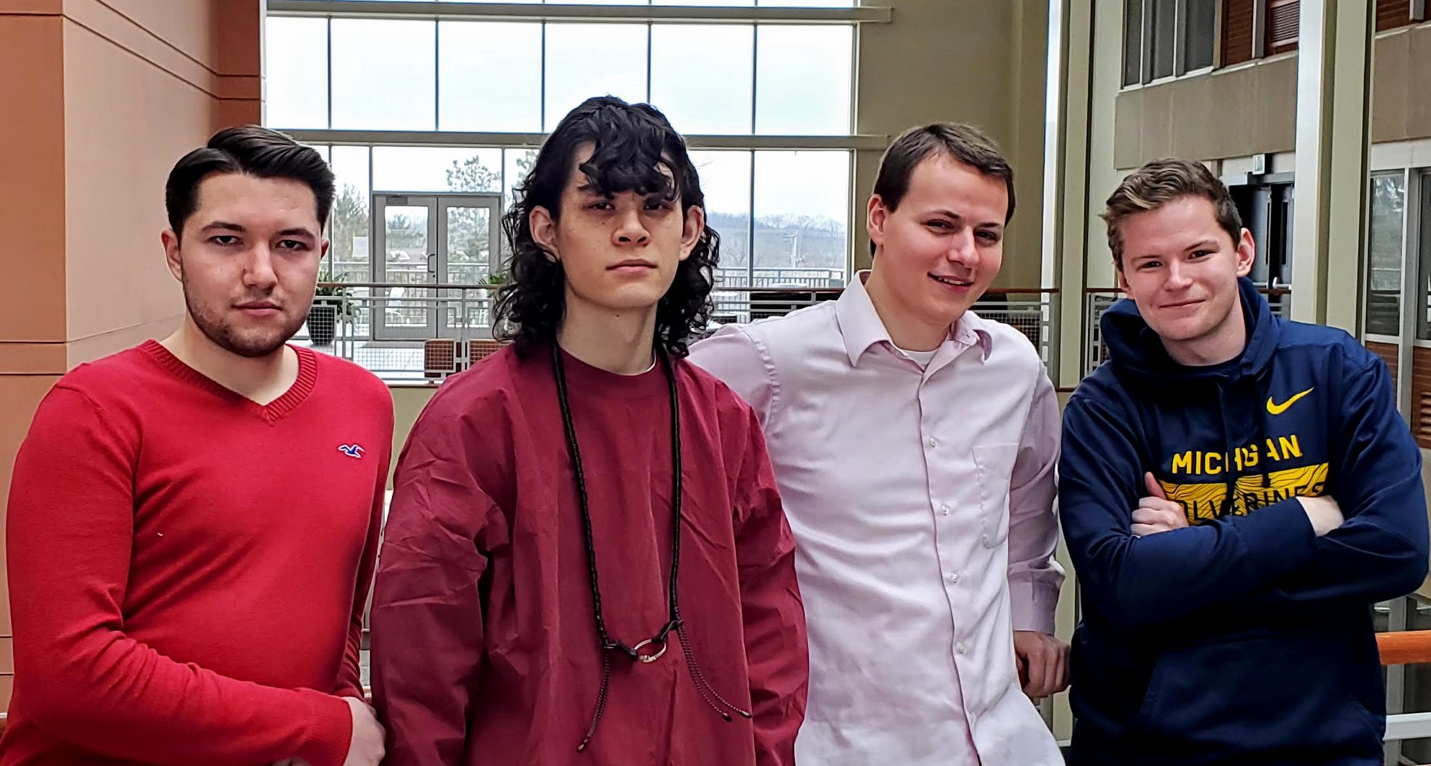
Thank you

